Slide 1

Moderated Panel: Community Perspectives on Business Retention/Attraction Moderator: Terry Clower, Professor of Public Policy, George Mason University Speakers: Jessica Heer - Senior Vice President, Talent Attraction, Say Yes to Dallas Michael Clark - Director, Roanoke Parks and Recreation Pete Eshelmen - Director of Outdoor Branding, Roanoke Regional Partnership Andy Shapiro - Corporate Location Advisory expert; Managing Director, Biggins Lacy Shapiro & Co
Notes:
http://www.thinkstockphotos.com/image/stock-photo-green-environment/161865156/popup?sq=sustainable/f=CPIHVX/p=2/s=DynamicRank
http://www.thinkstockphotos.com/image/stock-photo-group-of-multi-ethnic-kids-running-together/124425491/popup?sq=diverse%20runners/f=CPIHVX/s=DynamicRank
http://www.thinkstockphotos.com/image/stock-photo-group-of-young-children-running-towards/494209209/popup?sq=diverse%20playground/f=CPIHVX/p=2/s=DynamicRank
http://www.thinkstockphotos.com/image/stock-photo-people-doing-stretching-exercise-in-park/494377511/popup?sq=outdoor%20health/f=CPIHVX/p=3/s=DynamicRank
http://www.thinkstockphotos.com/image/stock-photo-asian-family/158898370/popup?sq=outdoor%20health/f=CPIHVX/p=6/s=DynamicRank

Slide 2
Speaker: Jessica Heer - Senior Vice President, Talent Attraction, Say Yes to Dallas
Notes:
http://www.thinkstockphotos.com/image/stock-photo-green-environment/161865156/popup?sq=sustainable/f=CPIHVX/p=2/s=DynamicRank
http://www.thinkstockphotos.com/image/stock-photo-group-of-multi-ethnic-kids-running-together/124425491/popup?sq=diverse%20runners/f=CPIHVX/s=DynamicRank
http://www.thinkstockphotos.com/image/stock-photo-group-of-young-children-running-towards/494209209/popup?sq=diverse%20playground/f=CPIHVX/p=2/s=DynamicRank
http://www.thinkstockphotos.com/image/stock-photo-people-doing-stretching-exercise-in-park/494377511/popup?sq=outdoor%20health/f=CPIHVX/p=3/s=DynamicRank
http://www.thinkstockphotos.com/image/stock-photo-asian-family/158898370/popup?sq=outdoor%20health/f=CPIHVX/p=6/s=DynamicRank

Slide 3




Slide 4


Dallas Regional Chamber

Slide 5

Market the Dallas Region to attract and retain top talent from Texas, the U.S. and abroad
Advocate and promote quality of life initiatives that are most important to attracting and retaining talent

Slide 6

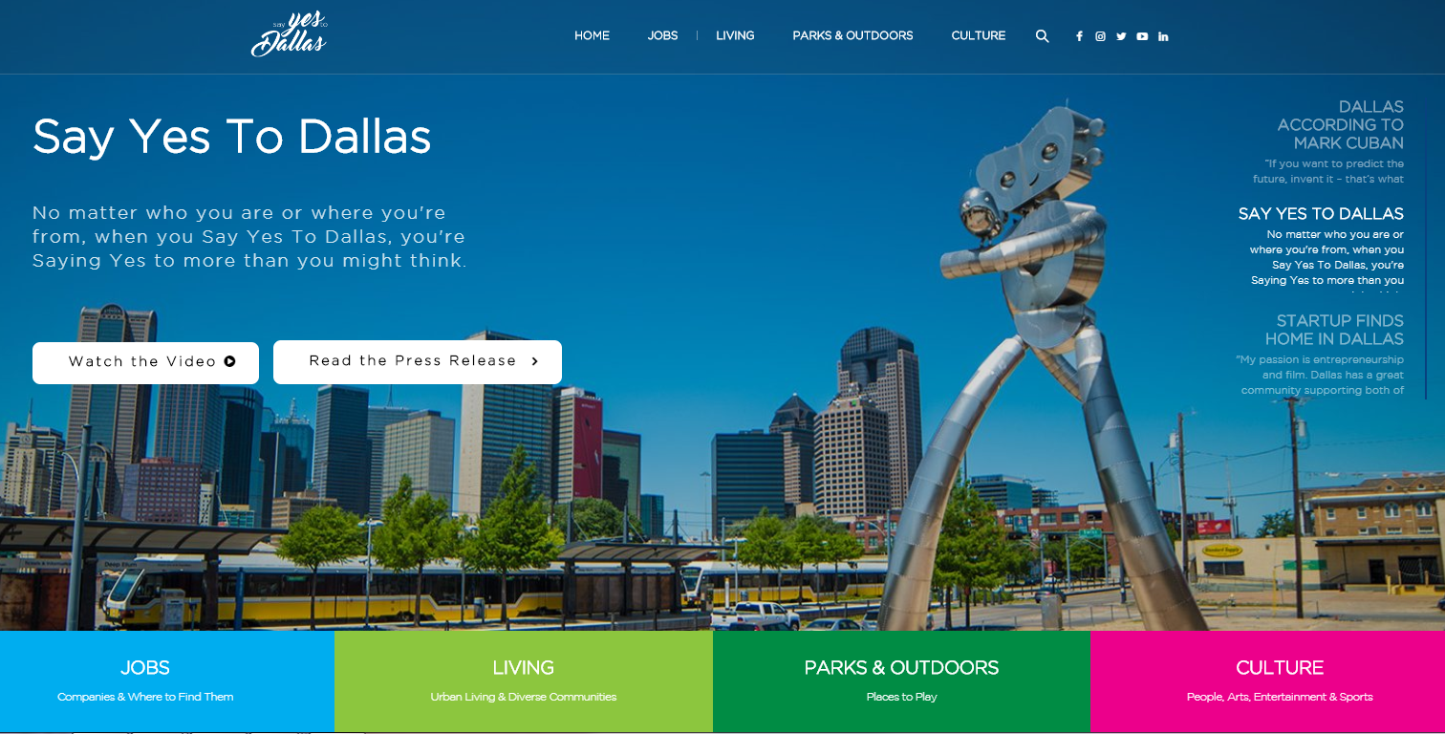




A marketing campaign aimed to attract the best and brightest workers to the Dallas Region
@ sayyestodallas | sayyestodallas.com

Slide 7
How did we get here?
2015
YEAR 1 | 2016
YEAR 2 | 2017
YEAR 3 | 2018
INFORMATION
GATHERING
ACTIVATION
BUILDING
STRATEGIC PLAN
SAY YES TO DALLAS
CAMPAIGN LAUNCH
(4/2017)

Slide 8

DFW
OCCUPATIONAL
SNAPSHOT
1 - 3%
UNEMPLOYMENT RATE
IN KEY OCCUPATIONS
Management, Legal, Finance, Health Care,
Computers, Architecture & Engineering

Slide 9

2016: Information Gathering
Nationwide Survey
1,000 Millennials
FOCUS GROUPS
Regional Assets
Availability & variety of jobs
Low cost of living
Regional Challenges
Public transportation
Commuting & traffic
61%
OF MILLENNIALS HAVE A FAVORABLE OPINION OF DALLAS
58%
OF MILLENNIALS WOULD CONSIDER MOVING TO DALLAS FOR THE RIGHT OPPORTUNITY

Slide 10
Survey: Moving Considerations
Affordability trumps other factors in terms of importance when considering a city to live followed by family, schools, and parks.
Please indicate how important each of the following items is in considering living in a large city.
Use a 0-10 scale with 0 being not important at all and 10 being extremely important.
Communications
Prioritization
Primary
Second tier
Third tier

Slide 11


2017
Activation
WEBSITE
SOCIAL MEDIA
INFLUENCERS
QUARTERLY MAGAZINE
VIDEOS
TESTIMONIALS
RECRUITING TOOLKIT
JOBS PORTAL
EVENTS

Slide 12
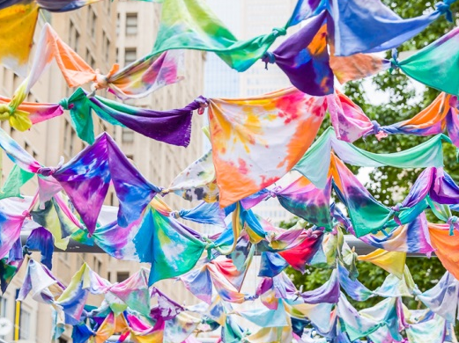
Defining Quality of life
JOBS
Search for jobs in the Dallas Region
Fortune 1000 & HQ
Major Employers
By Industry
LIVING
Urban Living
Dallas Neighborhoods
Beyond Dallas
Getting Around
Education
Housing
Live-Work-Play
Healthcare
PARKS & OUTDOORS
Parks & Trails
Walk & Roll
Lakes
Golf
It’s A Dog’s Life
Hidden Gems
CULTURE
People & Demographics
Arts
Sports
Shopping
Dining & Nightlife
Family
Giving Back
Sports

Slide 13
Outdoors
We love spending time outside because we can spend nearly 350 days a year outside, we find ways to foster outdoors and recreational opportunities.

Slide 14
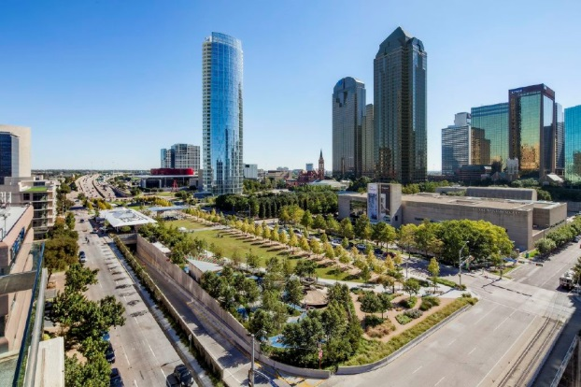
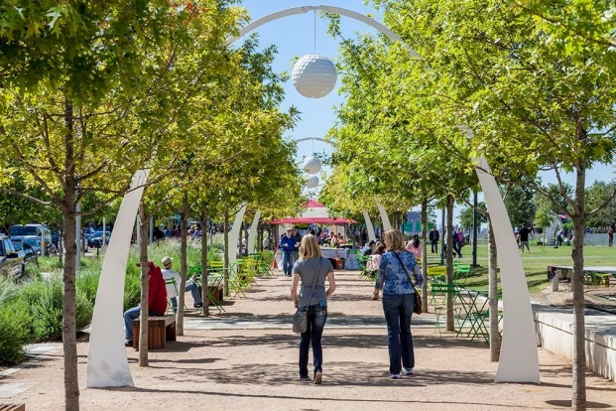
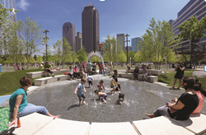
Outdoors
Klyde Warren Park
Situated over Woodall Rodgers Freeway between Pearl & Saint Paul Streets in Downtown Dallas
Performance pavilion, walking trails, dog park, children’s playground, games area
Free book signings, group exercise, movies, music, + more
Daily food trucks
Accessible by M-Line Trolley, DART, and D-link
2014 Urban Land Institute Urban Open Space Award
Notes:
Key Messages:
Downtown’s Klyde Warren Park isn’t just a green space—it’s an award-winning innovation. Situated over Woodall Rodgers Freeway between Pearl and Saint Paul streets, it is literally a park built on thin air. And it is an urban wonder. Within its 5 acres are a performance pavilion, a restaurant, walking trails, a mini dog park, a children’s playground, water features, an expansive lawn, and much more.

Slide 15
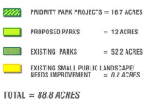
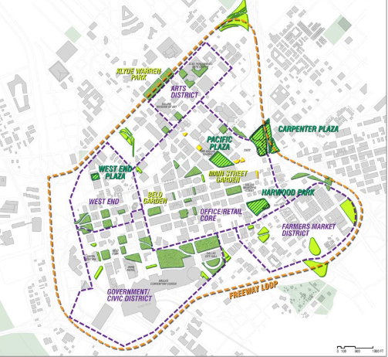
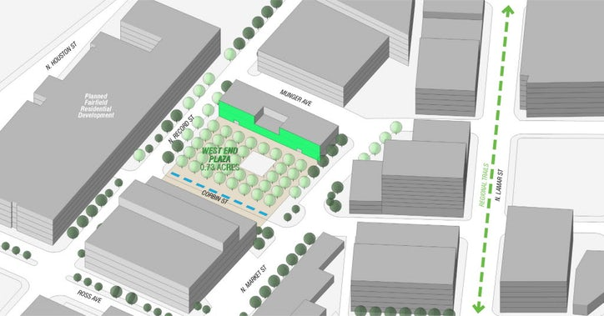
Outdoor & Recreational Activities: Katy Trail
Downtown Dallas Parks Master Plan transforming the business core into a more pedestrian oriented mixed-use area.
West End Plaza – A collaboration to create the Smartest Park in the United States.
Notes:
Dallas Innovation Alliance, a coalition of stakeholders invested in building a Smart City Phase I Living Lab in The West End area of downtown to differentiate Dallas as a leader in smart cities innovation.
West End Plaza: At three-quarters of an acre, dubbed the smartest park in America, the park grounds will be compact situated in the heart of one of downtown Dallas’ most historic districts. The area will have smart lighting, micro-grids, smart parking, smart EV stations, hydroponic offerings, interactive kiosks, smart art and museum exhibits, including installations highlighting the innovation that is happening all across North Texas, public Wi-Fi.

Slide 16
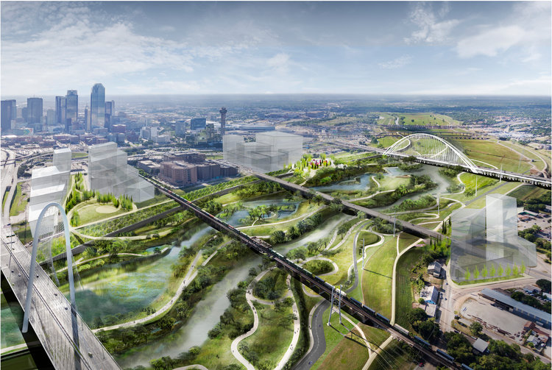
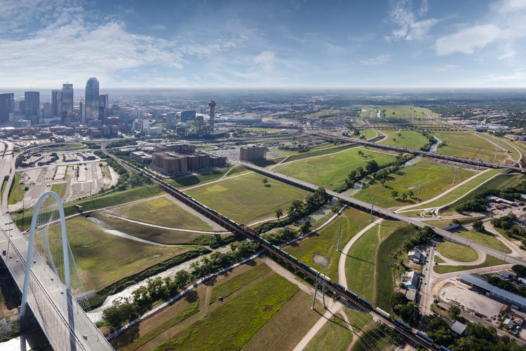
Outdoor & Recreational Activities: Katy Trail
Trinity River Project a 10,000-acre nature district – 11 times larger than Central Park.
Notes:
The city is building a 10,000-acre nature district— nearly 12 times as large as Manhattan's Central Park — along the Trinity River. Featuring plenty of walkways, sports fields, trees, and other flora, the site will become one of the largest urban parks in America.

Slide 17
Speakers: Michael Clark - Director, Roanoke Parks and Recreation Pete Eshelmen - Director of Outdoor Branding, Roanoke Regional Partnership
Notes:
http://www.thinkstockphotos.com/image/stock-photo-green-environment/161865156/popup?sq=sustainable/f=CPIHVX/p=2/s=DynamicRank
http://www.thinkstockphotos.com/image/stock-photo-group-of-multi-ethnic-kids-running-together/124425491/popup?sq=diverse%20runners/f=CPIHVX/s=DynamicRank
http://www.thinkstockphotos.com/image/stock-photo-group-of-young-children-running-towards/494209209/popup?sq=diverse%20playground/f=CPIHVX/p=2/s=DynamicRank
http://www.thinkstockphotos.com/image/stock-photo-people-doing-stretching-exercise-in-park/494377511/popup?sq=outdoor%20health/f=CPIHVX/p=3/s=DynamicRank
http://www.thinkstockphotos.com/image/stock-photo-asian-family/158898370/popup?sq=outdoor%20health/f=CPIHVX/p=6/s=DynamicRank

Slide 18
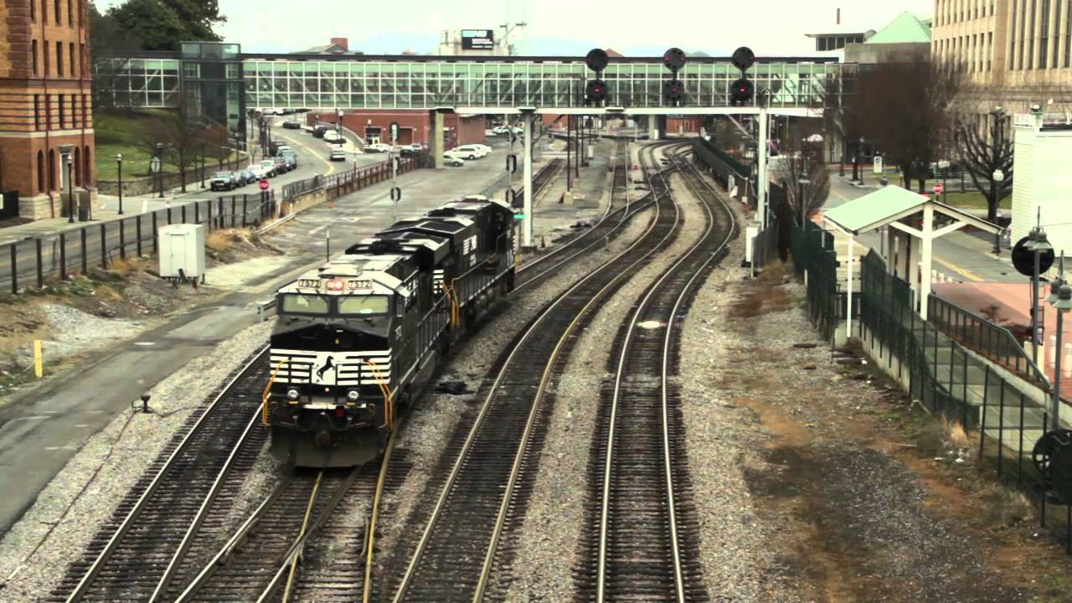

Slide 19
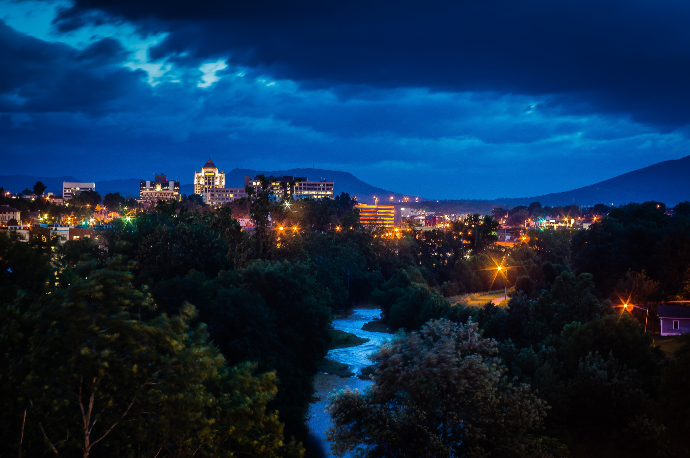


Slide 20
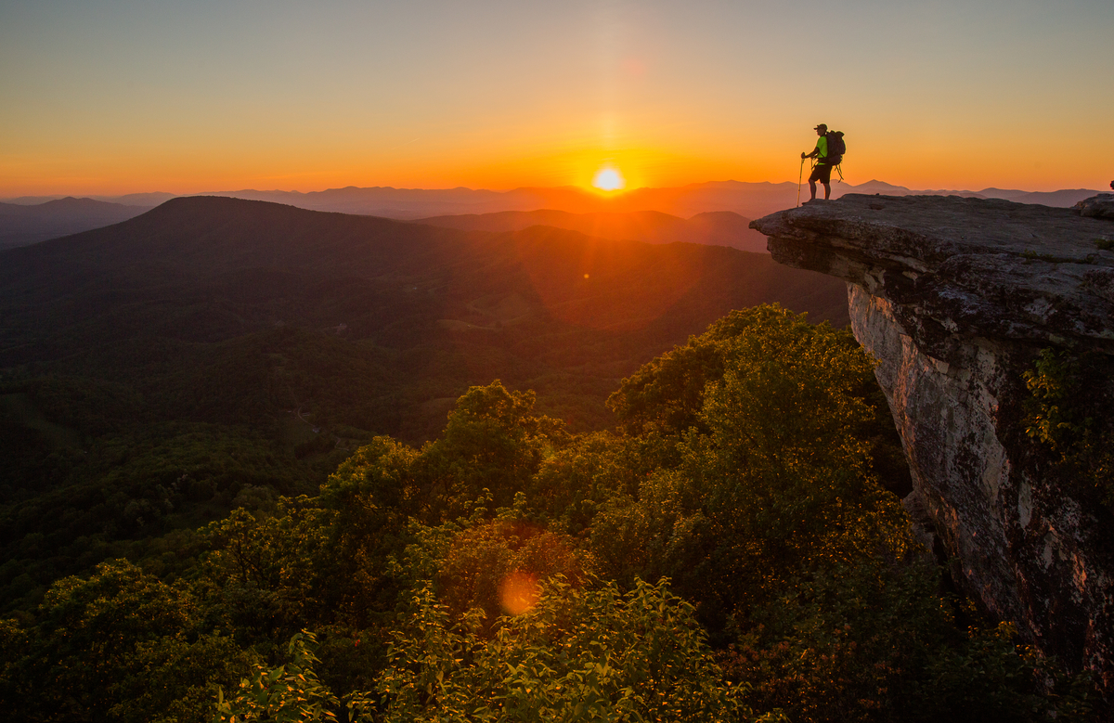

Slide 21





Slide 22
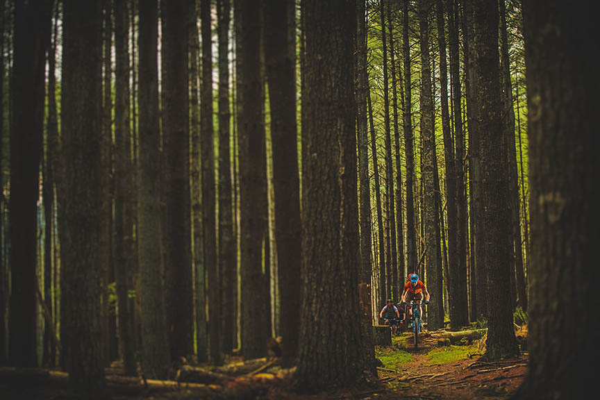

Slide 23
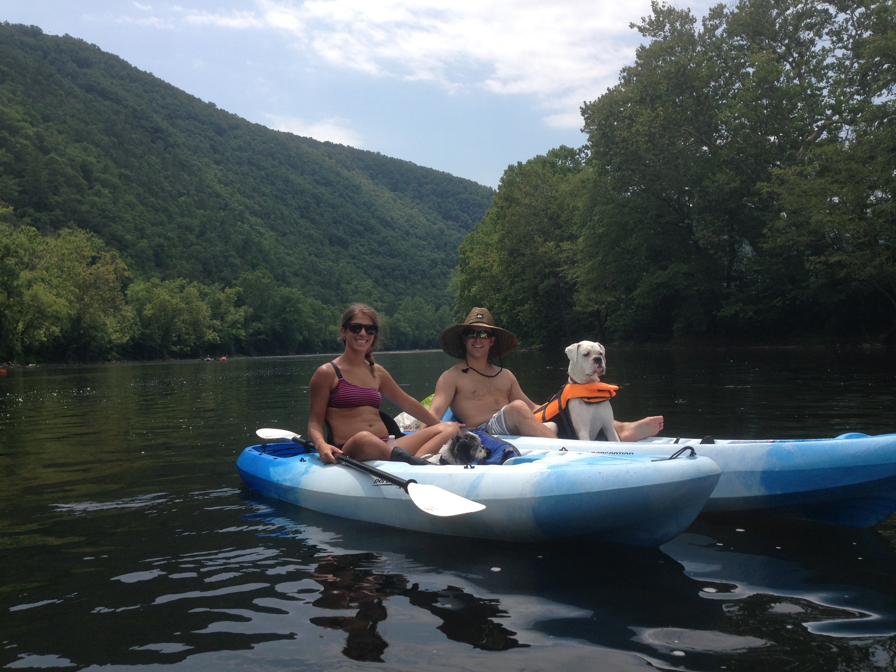

Slide 24
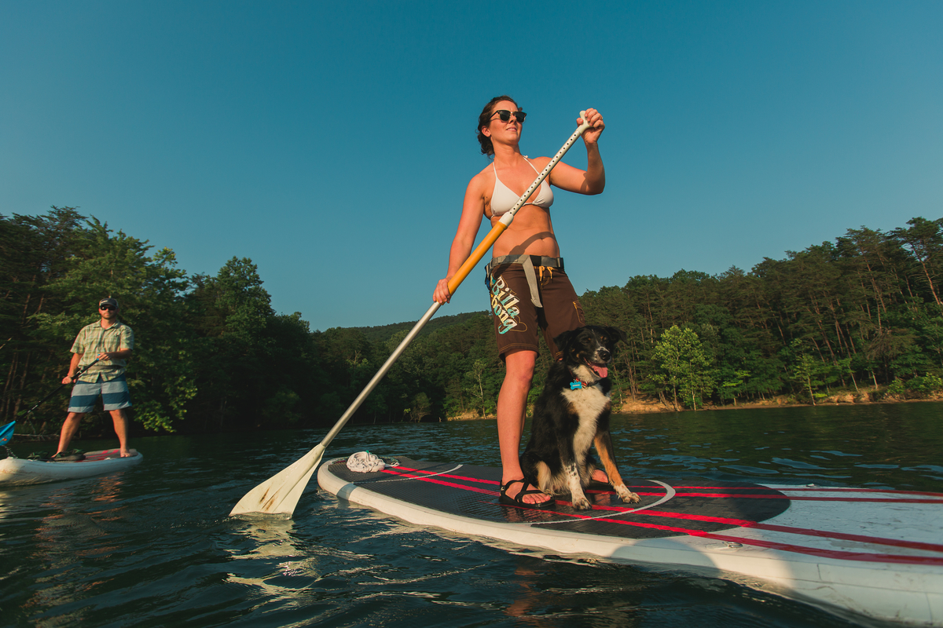

Slide 25
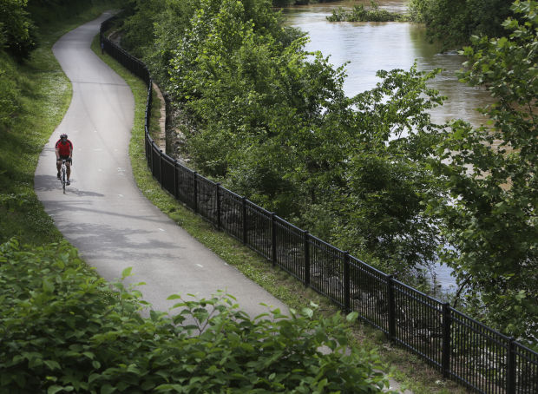

Slide 26
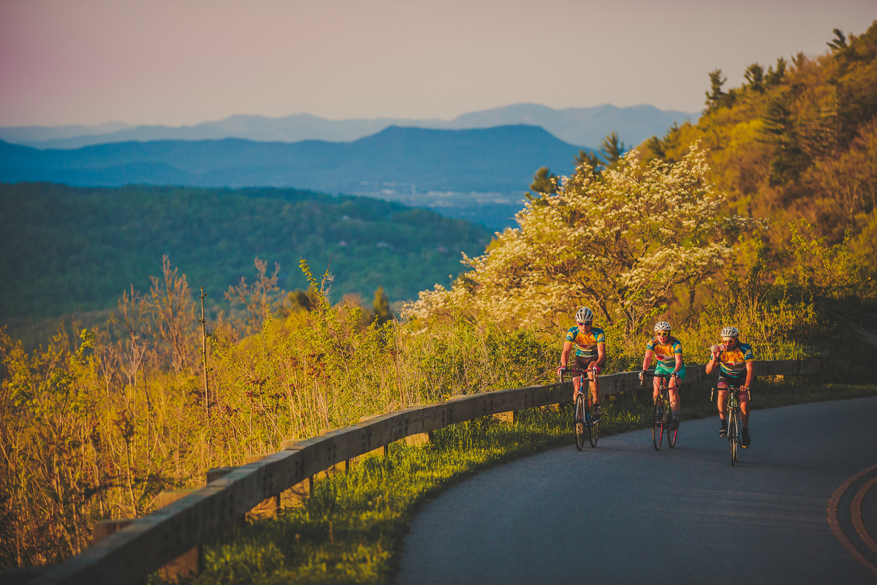

Slide 27
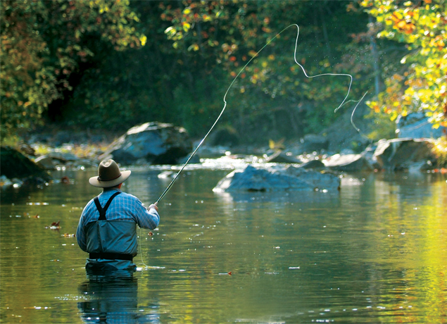

Slide 28
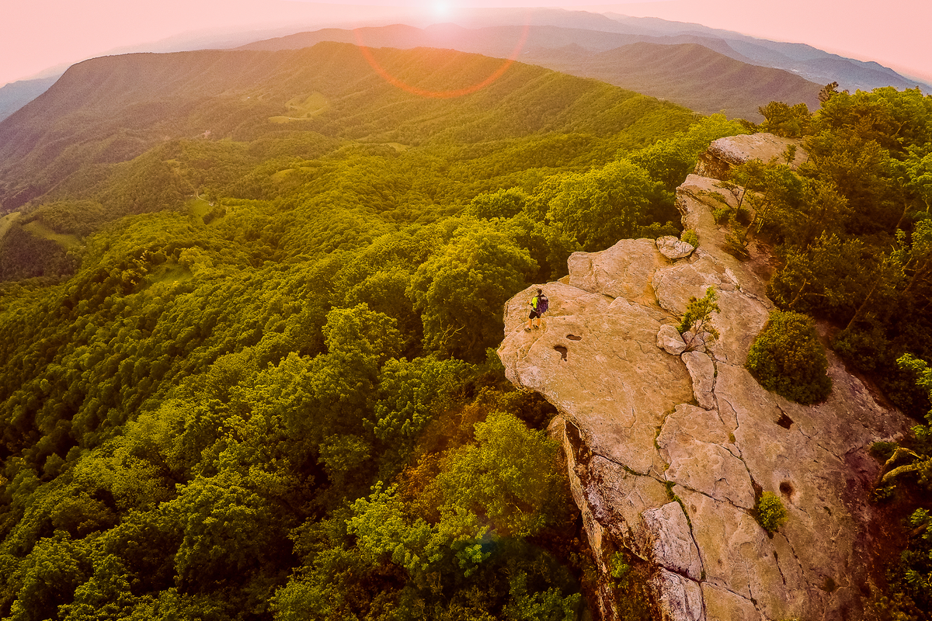

Slide 29
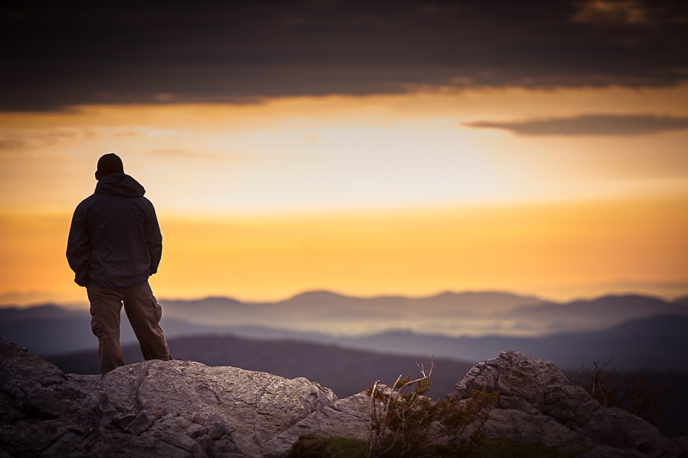
Build National Image
Build Local Support
Identify Gaps
Inventory Assets

Slide 30
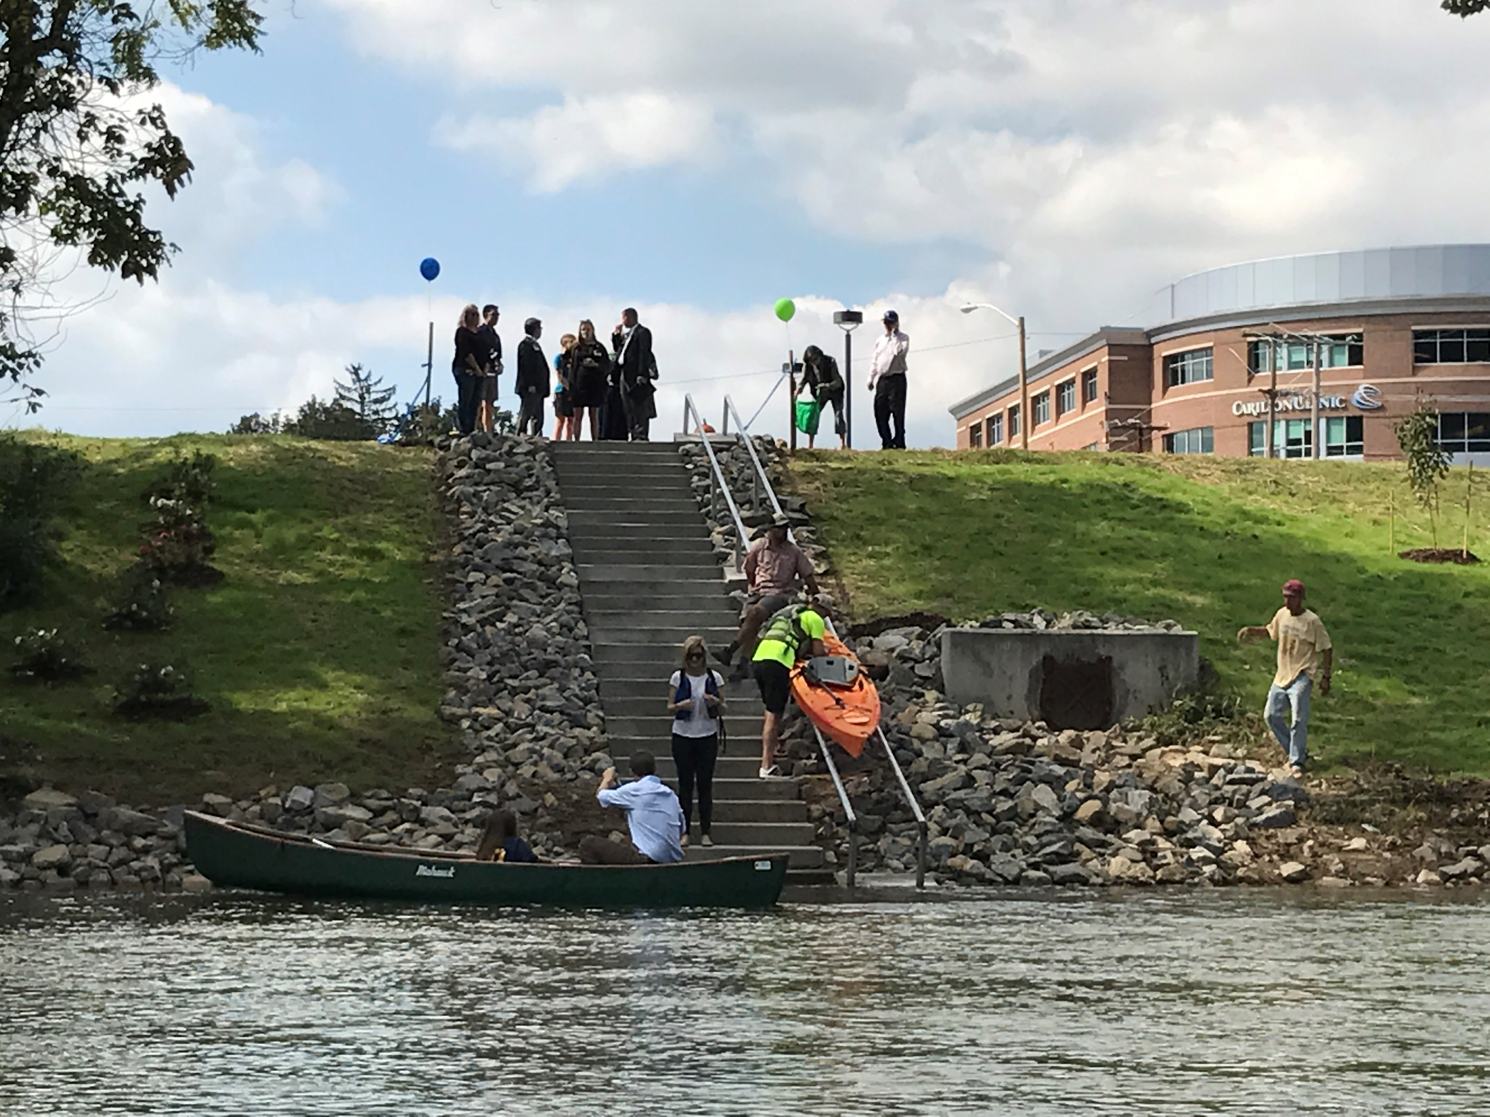

Slide 31
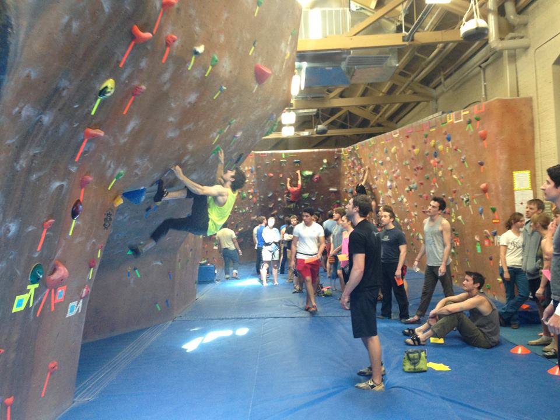

Slide 32
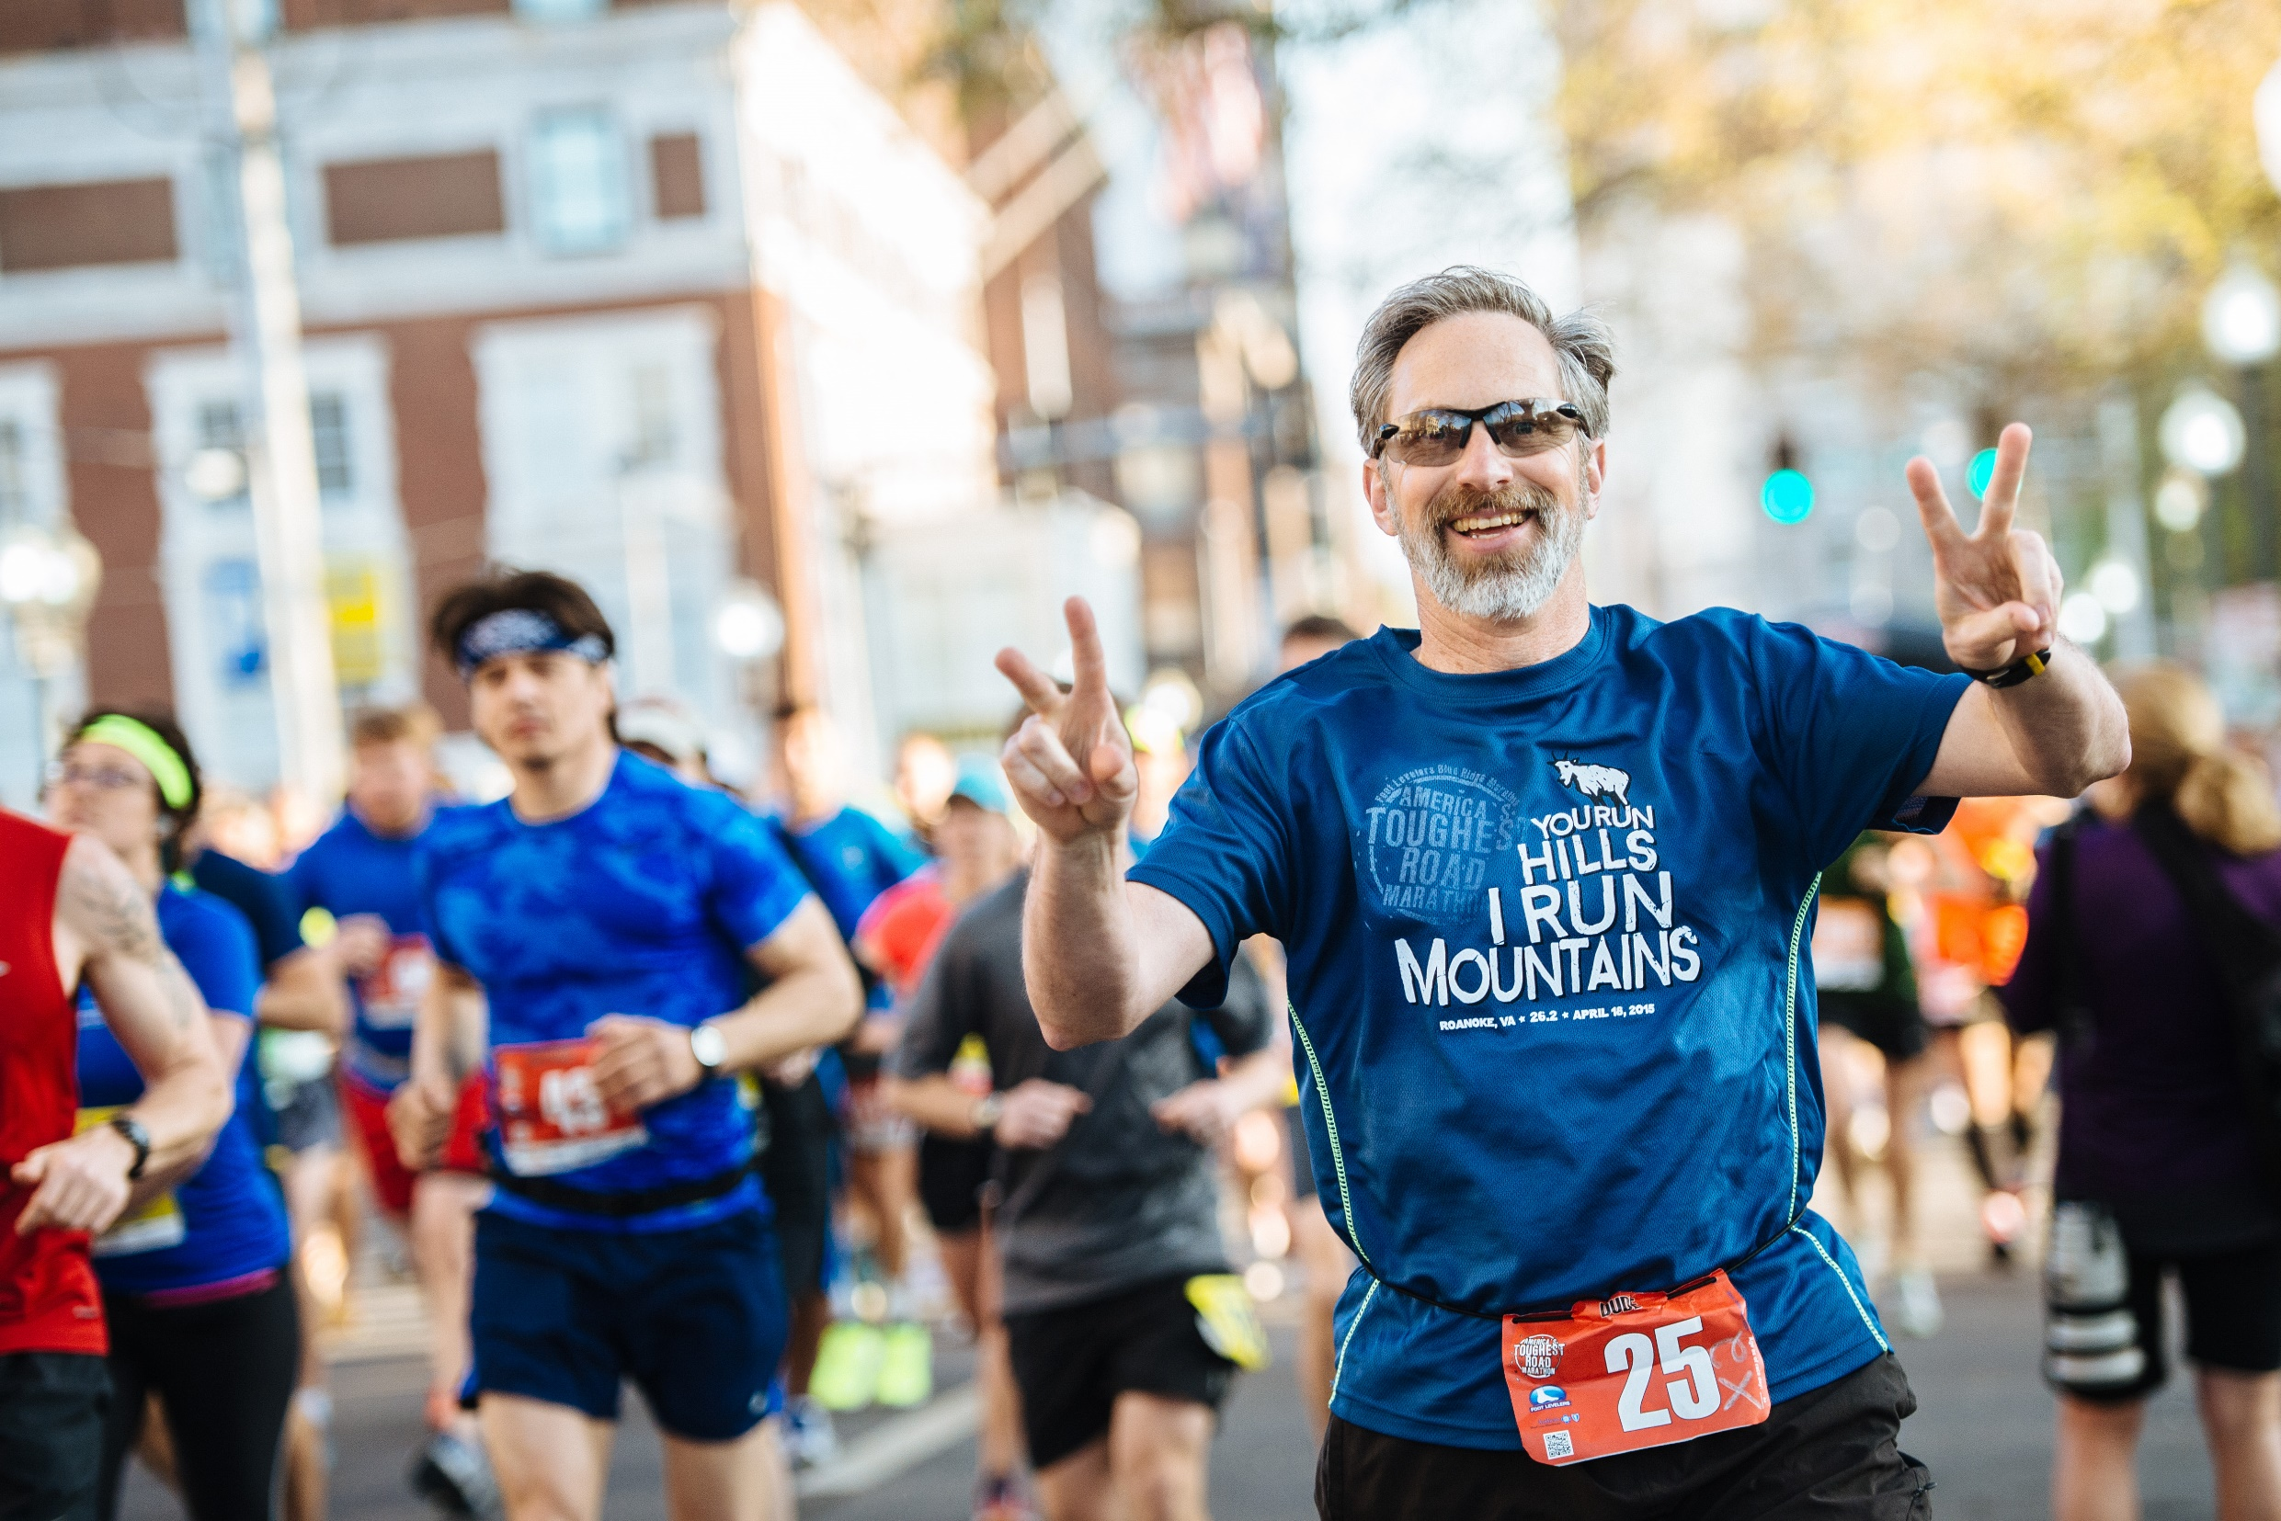


Slide 33
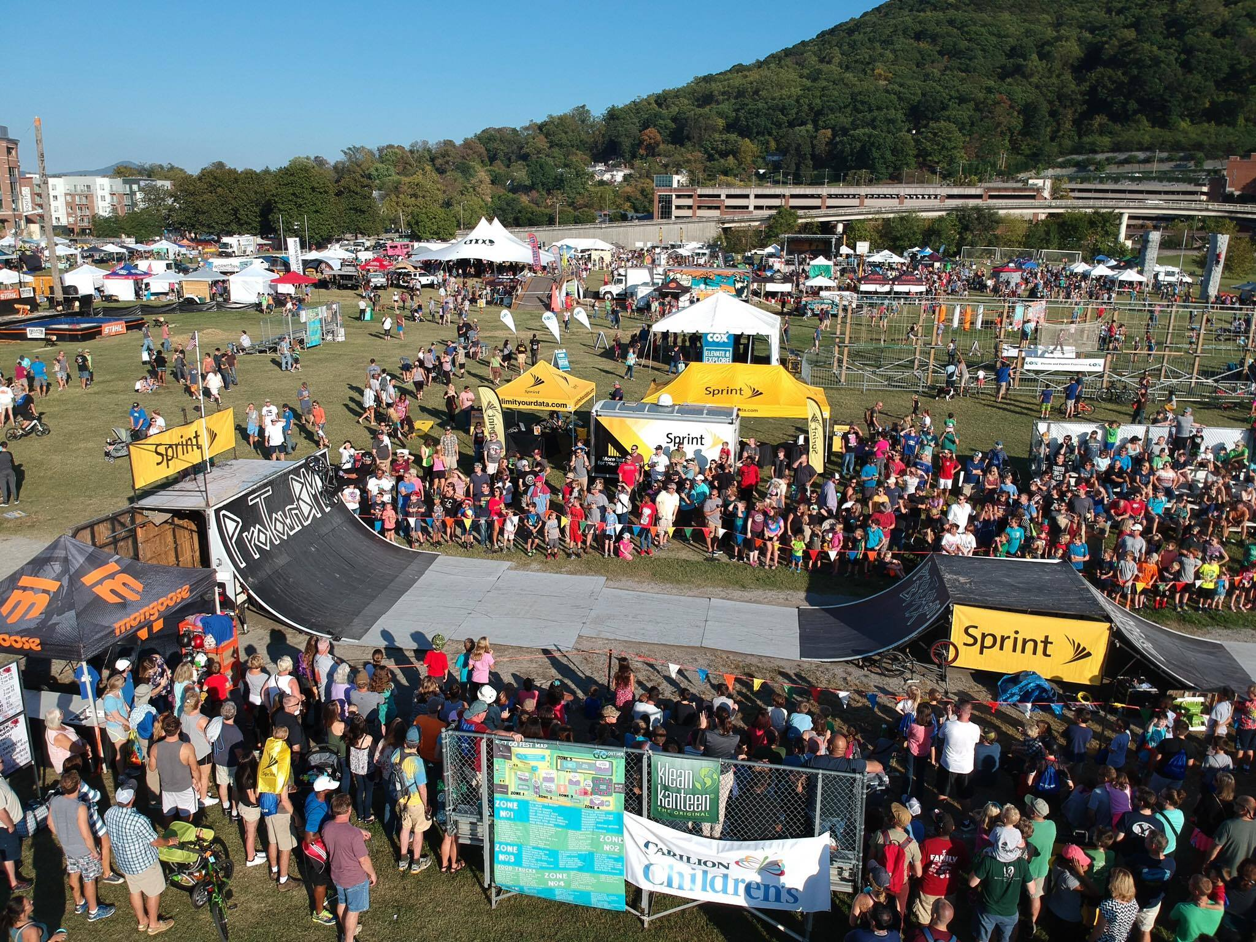


Slide 34
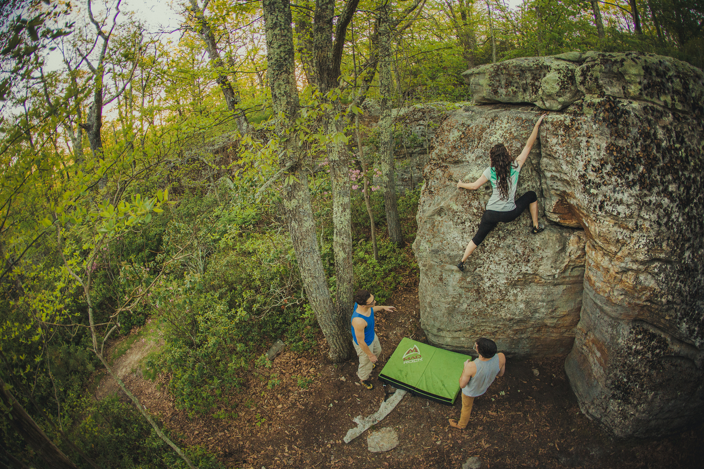

Slide 35
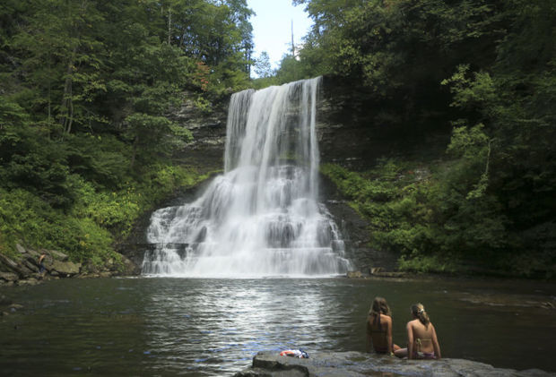

Slide 36
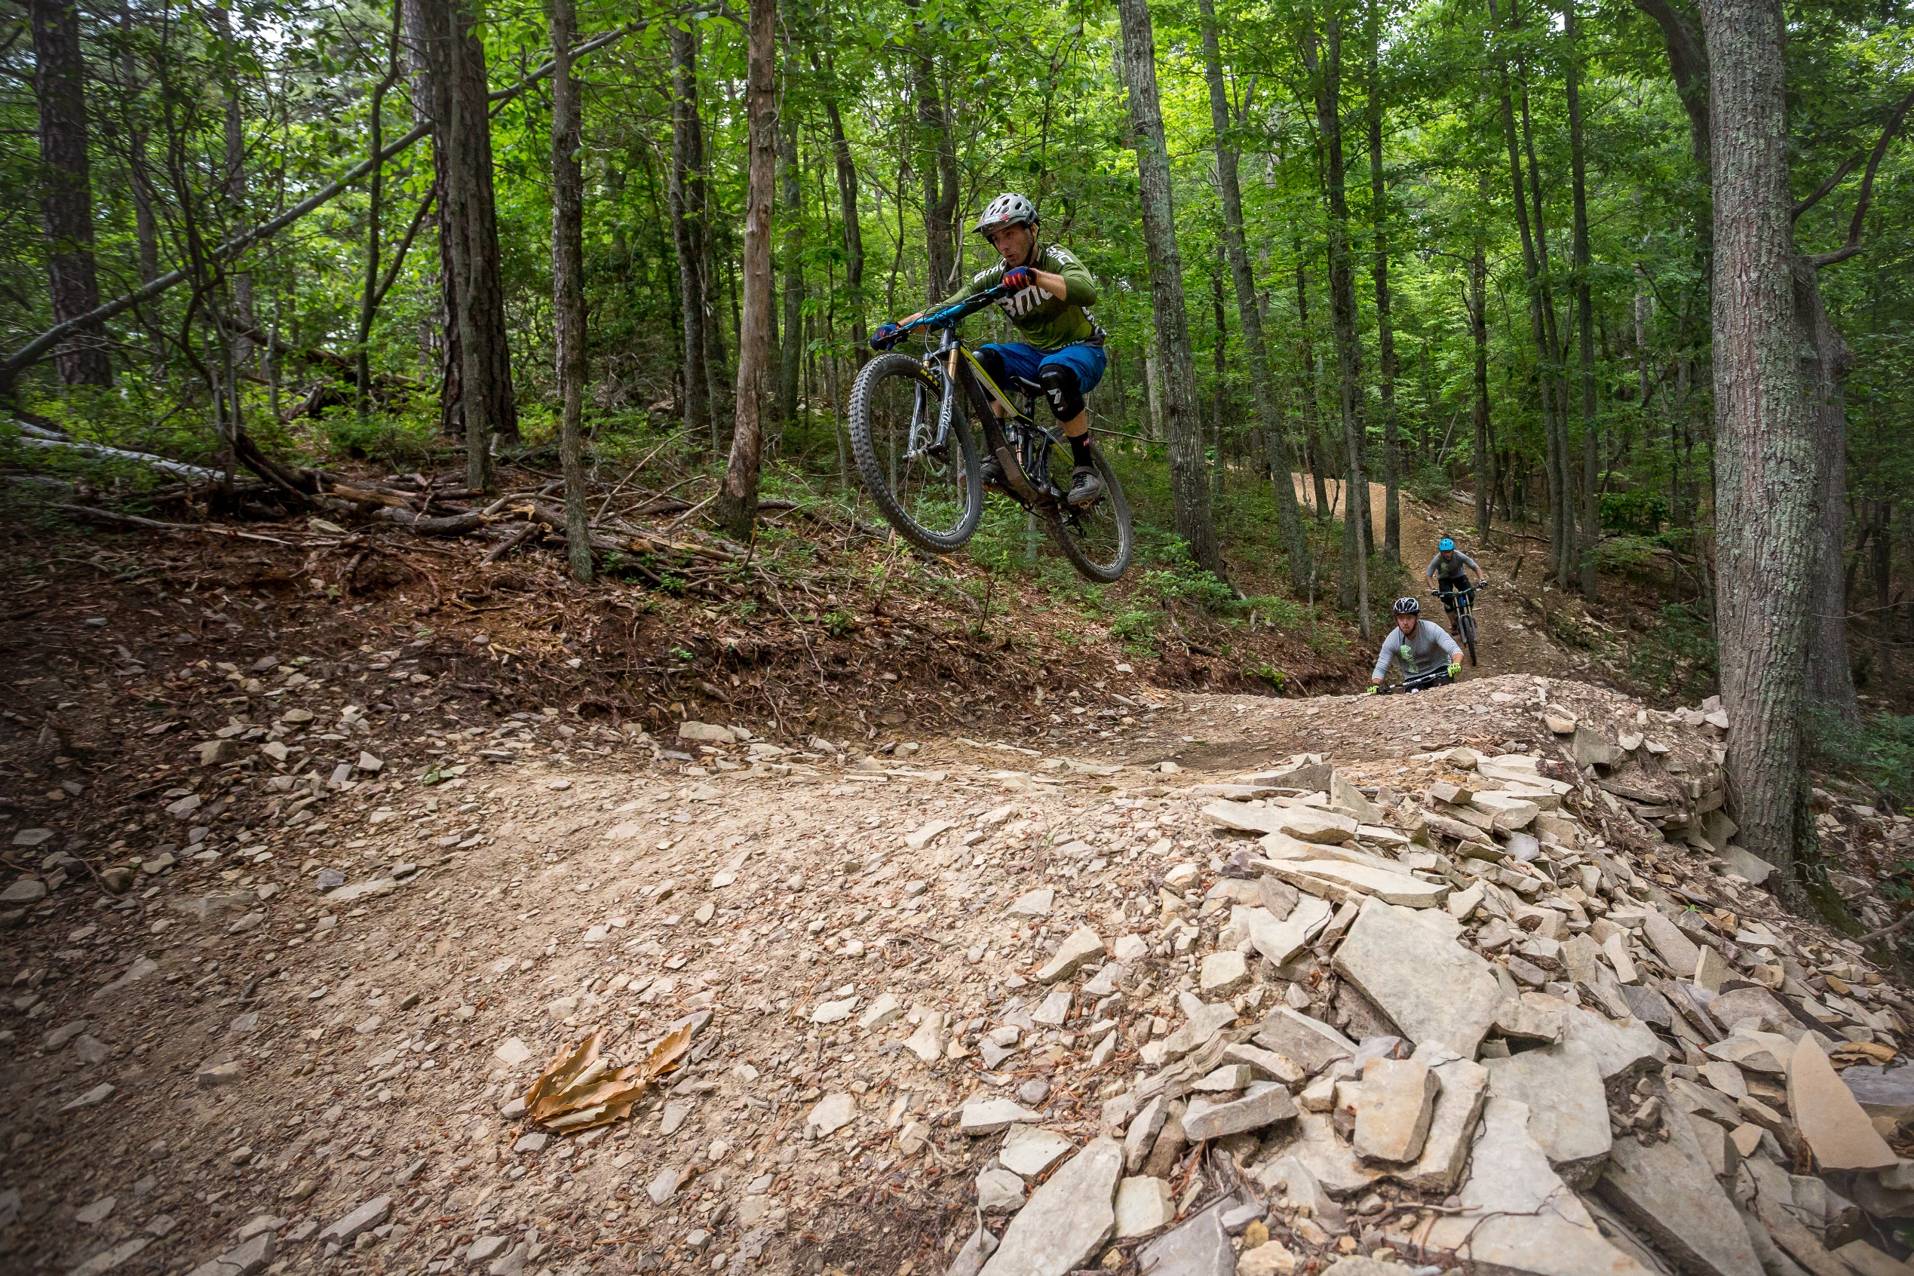

Slide 37
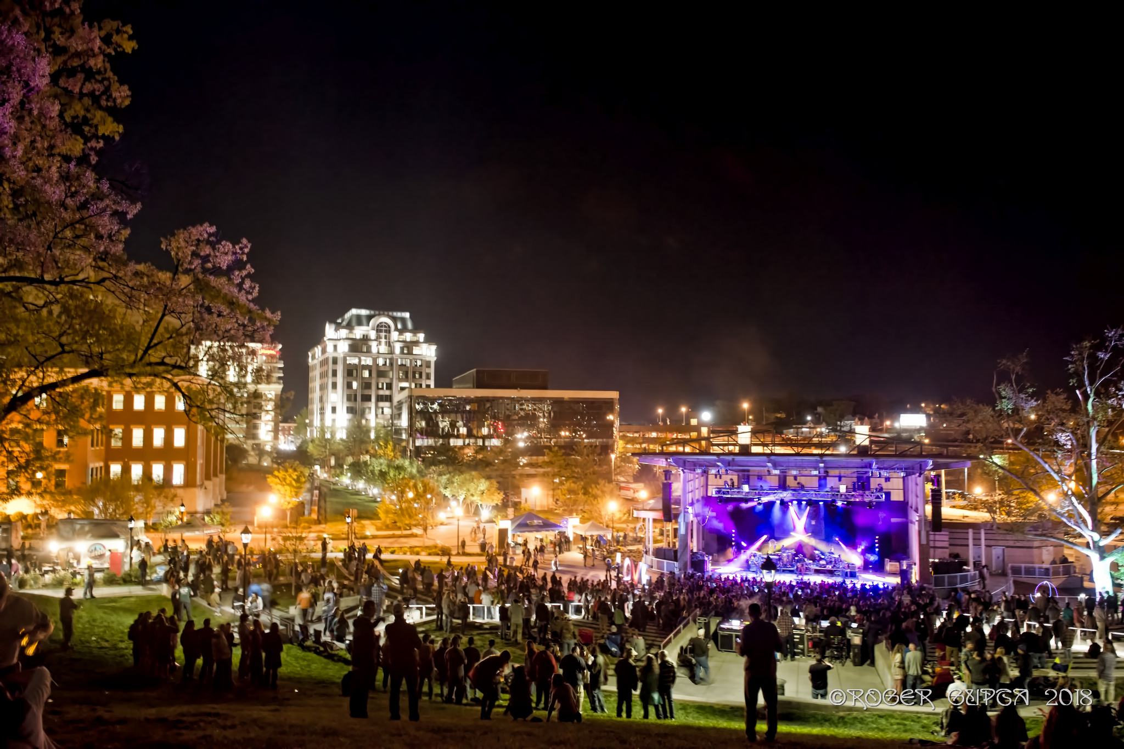

Slide 38
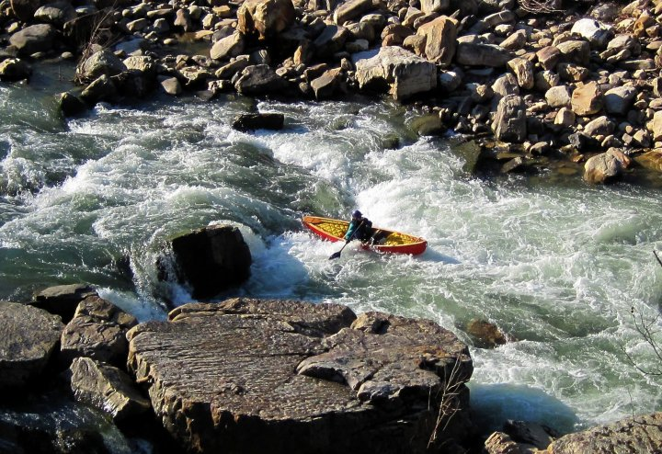

Slide 39
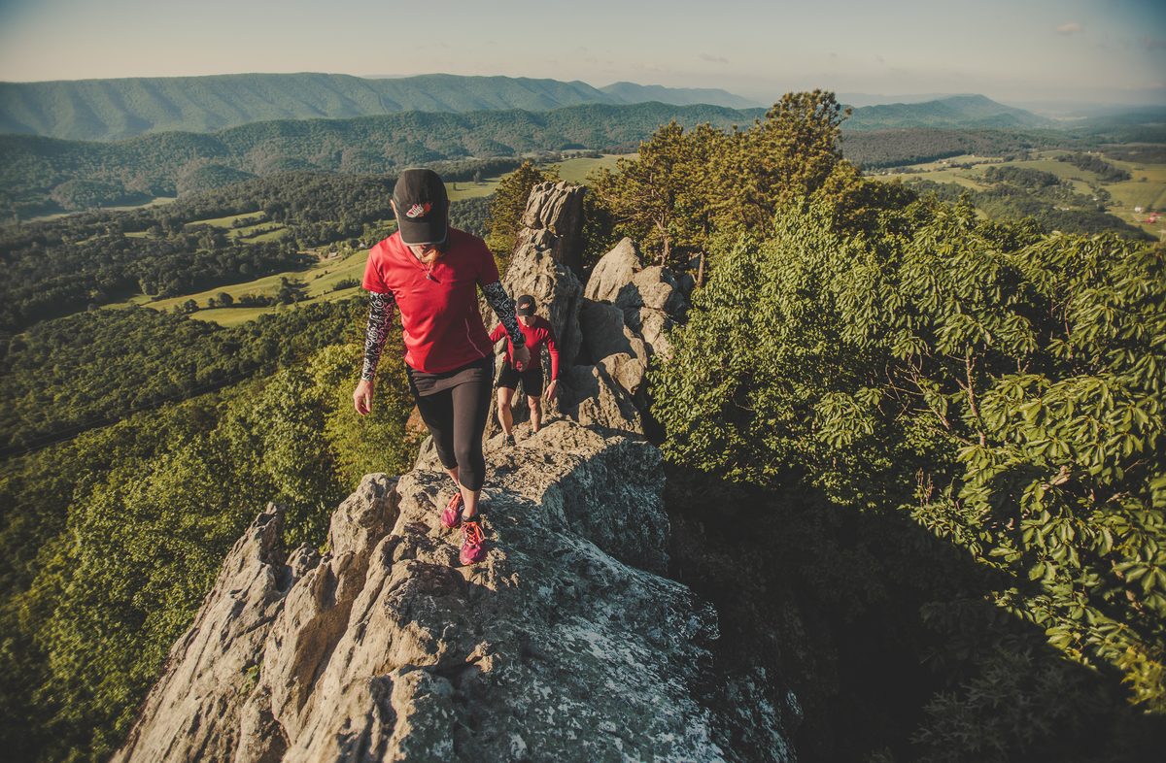

Slide 40
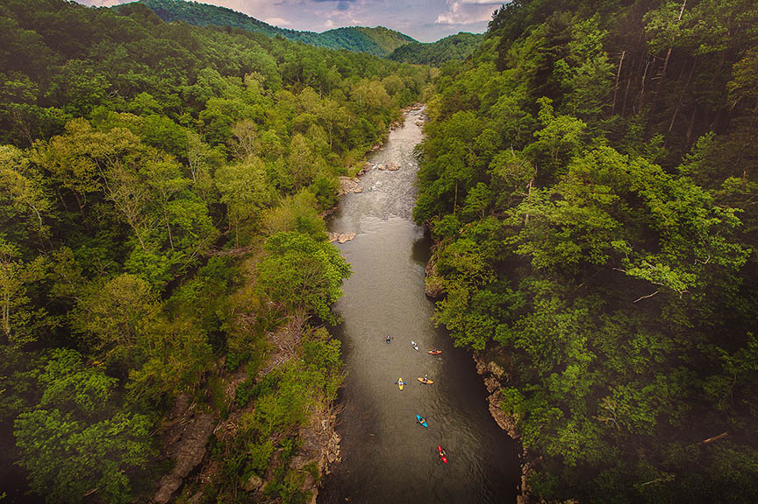

Slide 41
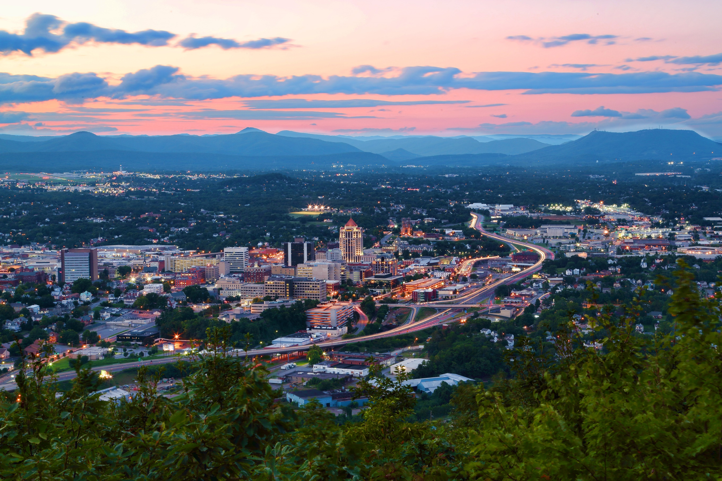

Slide 42


PARKS AND QUALITY OF LIFE: PERSPECTIVES ON BUSINESS ATTRACTION
Presented by:
Andy Shapiro
Biggins Lacy Shapiro & Company
Walnut Creek, CA
May 18, 2018

Slide 43
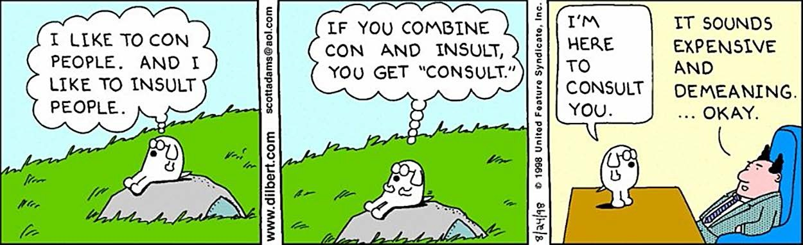
Just what you need . . . a consultant

Slide 44
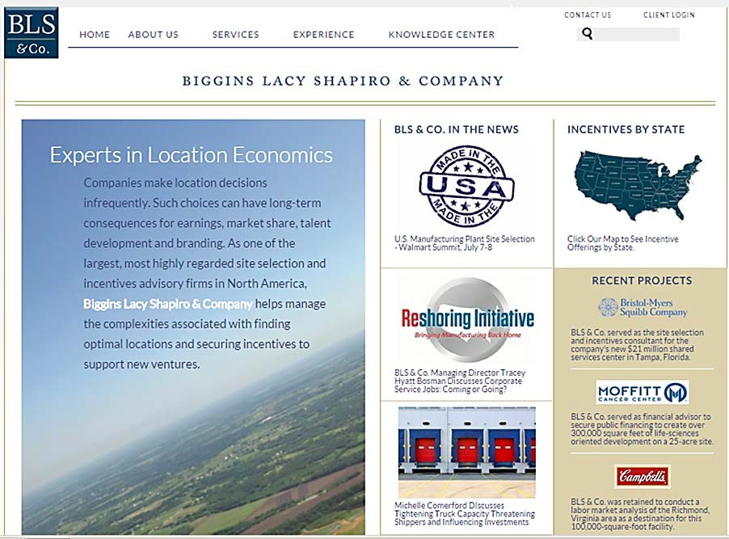

Biggins Lacy Shapiro & Co

Slide 45





Our perspective
Business Attraction
Business Retention
Economic Development
Entrepreneurship
Community Development

Slide 46

Now more than ever, site selection is a process of elimination
Start with Many Potential Destinations Dispense with the Least
Desirable
Assess and Compare the Rest
Identify the Leaders
Assess and Compare Again
Negotiate
Select
Community’s Goal: Avoid Elimination

Slide 47




There is no “best” location for all businesses
 A project’s drivers, and thus its choice of destination, will vary by business needs
Reduce costs
Achieve operational efficiencies
Access raw materials and markets
Manufacturing
Attract top-level scientific or technical talent
Commercialize discoveries
Reach investors
R&D
Acquire marketing & financial talent
Network with industry leaders
Link with global community
Headquarters
Offer attractive quality of life
Mission Critical Ops
Purchase low cost power
Enjoy reliable infrastructure
Avoid disaster risk

Slide 48

How important are parks in location decisions?
. . . It depends

Slide 49







Quality of Life variables rarely drive location decisions
Location Decision Variables
Regulation
Quality of Life
Sites & Infrastructure
Risk
Proximity
Costs
Talent
Generally Lower Priority
Generally Higher Priority

Slide 50

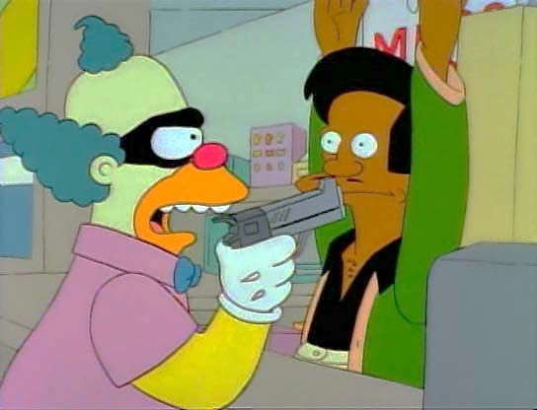
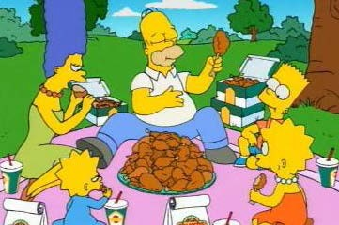
Among Quality of Life factors, amenities such as parks are typically less influential than those that address day-to-day needs
Costs of Living
Crime
Congestion
Higher to Lower Priority
Daily Living Concerns
Schools & Neighborhoods
Climate
Healthcare
Quality of Life
Culture
Shopping
Amenities
Recreation
Social & Religious
VS.

Slide 51
Quality of Life measures can be most meaningful when they help dictate a project’s direction at the outset
✓
“Must Have”
“Would Like to Have”
✓
Later in Project
Early in Project
9
10

Slide 52
Or when the particular circumstances of a project makes Quality of Life more consequential
PROJECT TYPE | More Important | Important | Less Important | Not Important
Knowledge Intensive |  | ✓
Capital Intensive |  |  | ✓
Talent Driven | ✓
Cost Driven |  |  | ✓
Brand Driven | ✓
Value Driven |  |  |  | ✓
Recruit Nationally | ✓
Recruit Locally |  |  |  | ✓
Relocating Employees | ✓
Few/No Relocations |  |  | ✓
Public Company |  |  | ✓
Private Company |  | ✓
Decision-Maker Moves |  | ✓
Decision-Maker Stays |  |  | ✓
10

Slide 53

Does this mean that there is rarely a role for parks in the business recruitment process?
. . . Uh, No.

Slide 54

Parks and recreation are among the few location variables that local or regional government can control
Its important that you be on the team
Urge that that prospect information be shared with you on a timely basis
Learn to identify which types of prospects are most open to your message (e.g., brand- or talent-driven projects)
Educate your partners about when to involve you
Deliver value when given the opportunity

Slide 55
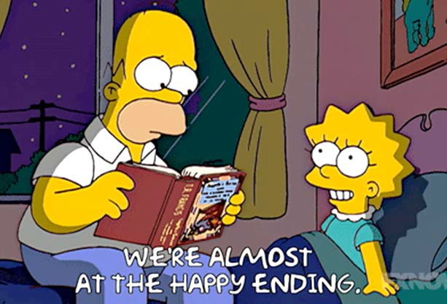
So, that’s all you need to do?

Slide 56

Princeton, NJ
New York, NY Chicago, IL www.BLSstrategies.com
ashapiro@BLSstrategies.com 609.651.7765
Walnut Creek, CA

